Slide 1


Insurance Customer Response Prediction
CONFIDENTIAL: The information in this document belongs to Boston Institute of Analytics LLC. Any unauthorized sharing of this material is prohibited and subject to legal action under breach of IP and confidentiality clauses.

Slide 2
Agenda
Introduction
Data Overview
Data Preprocessing
Feature Selection
Model Selection
Evalution Matrics
Results

Slide 3
Introduction
Introduce the problem of predicting insurance customers who are likely to buy a vehicle insurance policy based on their demographics and behavior.
We aim to solve this problem by leveraging machine learning algorithms to predict customer behavior, enabling data-driven decision-making and improving accuracy in insurance risk assessments.
Predicting whether a customer will respond to an insurance offer allows companies to: ✅ Improve targeting strategies ✅ Optimize marketing costs ✅ Enhance customer retention

Slide 4
Data Overview
1. id: unique identifier for each record
2. Gender: Gender of the policyholder
3. Age: Age of the policyholder
4. Driving_License: Indicates if the person has a driving license
5. Region_Code: Code representing the geographic region
6. Previously_Insured: Whether the person was previously insured
7. Vehicle_Age: Age of the vehicle
8. Vehicle_Damage: Indicates if the vehicle has been damaged
9. Annual_Premium: The yearly insurance premium amount
10. Policy_Sales_Channel: The channel through which the policy was sold
11. Vintage: length of time as a customer or policy age
12. Response: Indicating policy renewal or claim filing

Slide 5
DATA VISUALIZATION
The data visualization providing insights into the distribution of numerical features and the relationship between variables. The visualizations will help in identifying patterns and correlations in the data.

Slide 6
Model Selection
Model selection is a critical step in the machine learning pipeline, where different algorithms are evaluated to determine the best fit for the problem at hand. The goal is to select a model that balances performance with complexity, ensuring it generalizes well to unseen data.
Model Training
Hyperparameter Tuning
Hyperparameter tuning optimizes a model's preset parameters to enhance performance. Techniques like Random Search help find the best parameter combinations for accurate predictions.
Model Evaluation
Model evaluation assesses the performance of a trained model using metrics like accuracy, precision, recall, and F1-score. This ensures the model's predictions are reliable and generalize well to new data.
Save
The trained model is saved for future use, allowing predictions without retraining. It is saved using techniques like joblib ensuring efficient storage and easy deployment for real-world applications.

Slide 7
✅ Accuracy Score – Measures overall correctness of predictions. ✅ Precision Score – Determines how many predicted responce were actually correct. ✅ Recall Score – Measures how well the model identifies actual successes. ✅ F1-Score – Balances precision and recall. ✅ Confusion Matrix – Provides a detailed breakdown of predictions. ✅ Classification Report – Shows precision, recall, F1-score, and support for each class.
Evalution Matrics

Slide 8
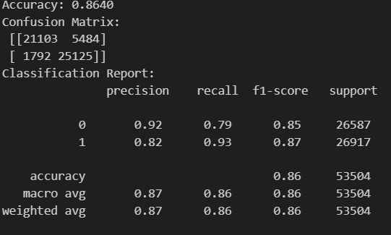
Result
✅ Best Performing Model: Random Forest with 86% accuracy. ✅ Best Model Performance:

Slide 9
Conclusion
Machine Learning effectively predicted customer behaviour, enabling improved decision-making.
Random forest is the top performing models, offering high accuracy and reliability.
The project demonstrated how data preprocessing, feature selection, and model tuning contribute to better model performance.
Saved models provide a foundation for future use and scalability in real=world applications.
Model Summary:
The cross-validation technique has been successfully applied, providing insights into the model’s performance on unseen data. The results show that the random forest classifier has the highest mean accuracy and lowest standard deviation, so it is best performer.

Slide 10
Questions ?

Slide 11
Thank You!
CONFIDENTIAL: The information in this document belongs to Boston Institute of Analytics LLC. Any unauthorized sharing of this material is prohibited and subject to legal action under breach of IP and confidentiality clauses.

